Slide 1
How does the election affect the U.S. real estate market?
Uncertainty

Slide 2
Trade
Will President Trump attempt to re-negotiate NAFTA and TPP?
Will his administration impose tariffs and penalties for what it deems unfair trade?
Trade disrupts industries, but its net adds to the standard of living, not necessarily GDP.

Slide 3
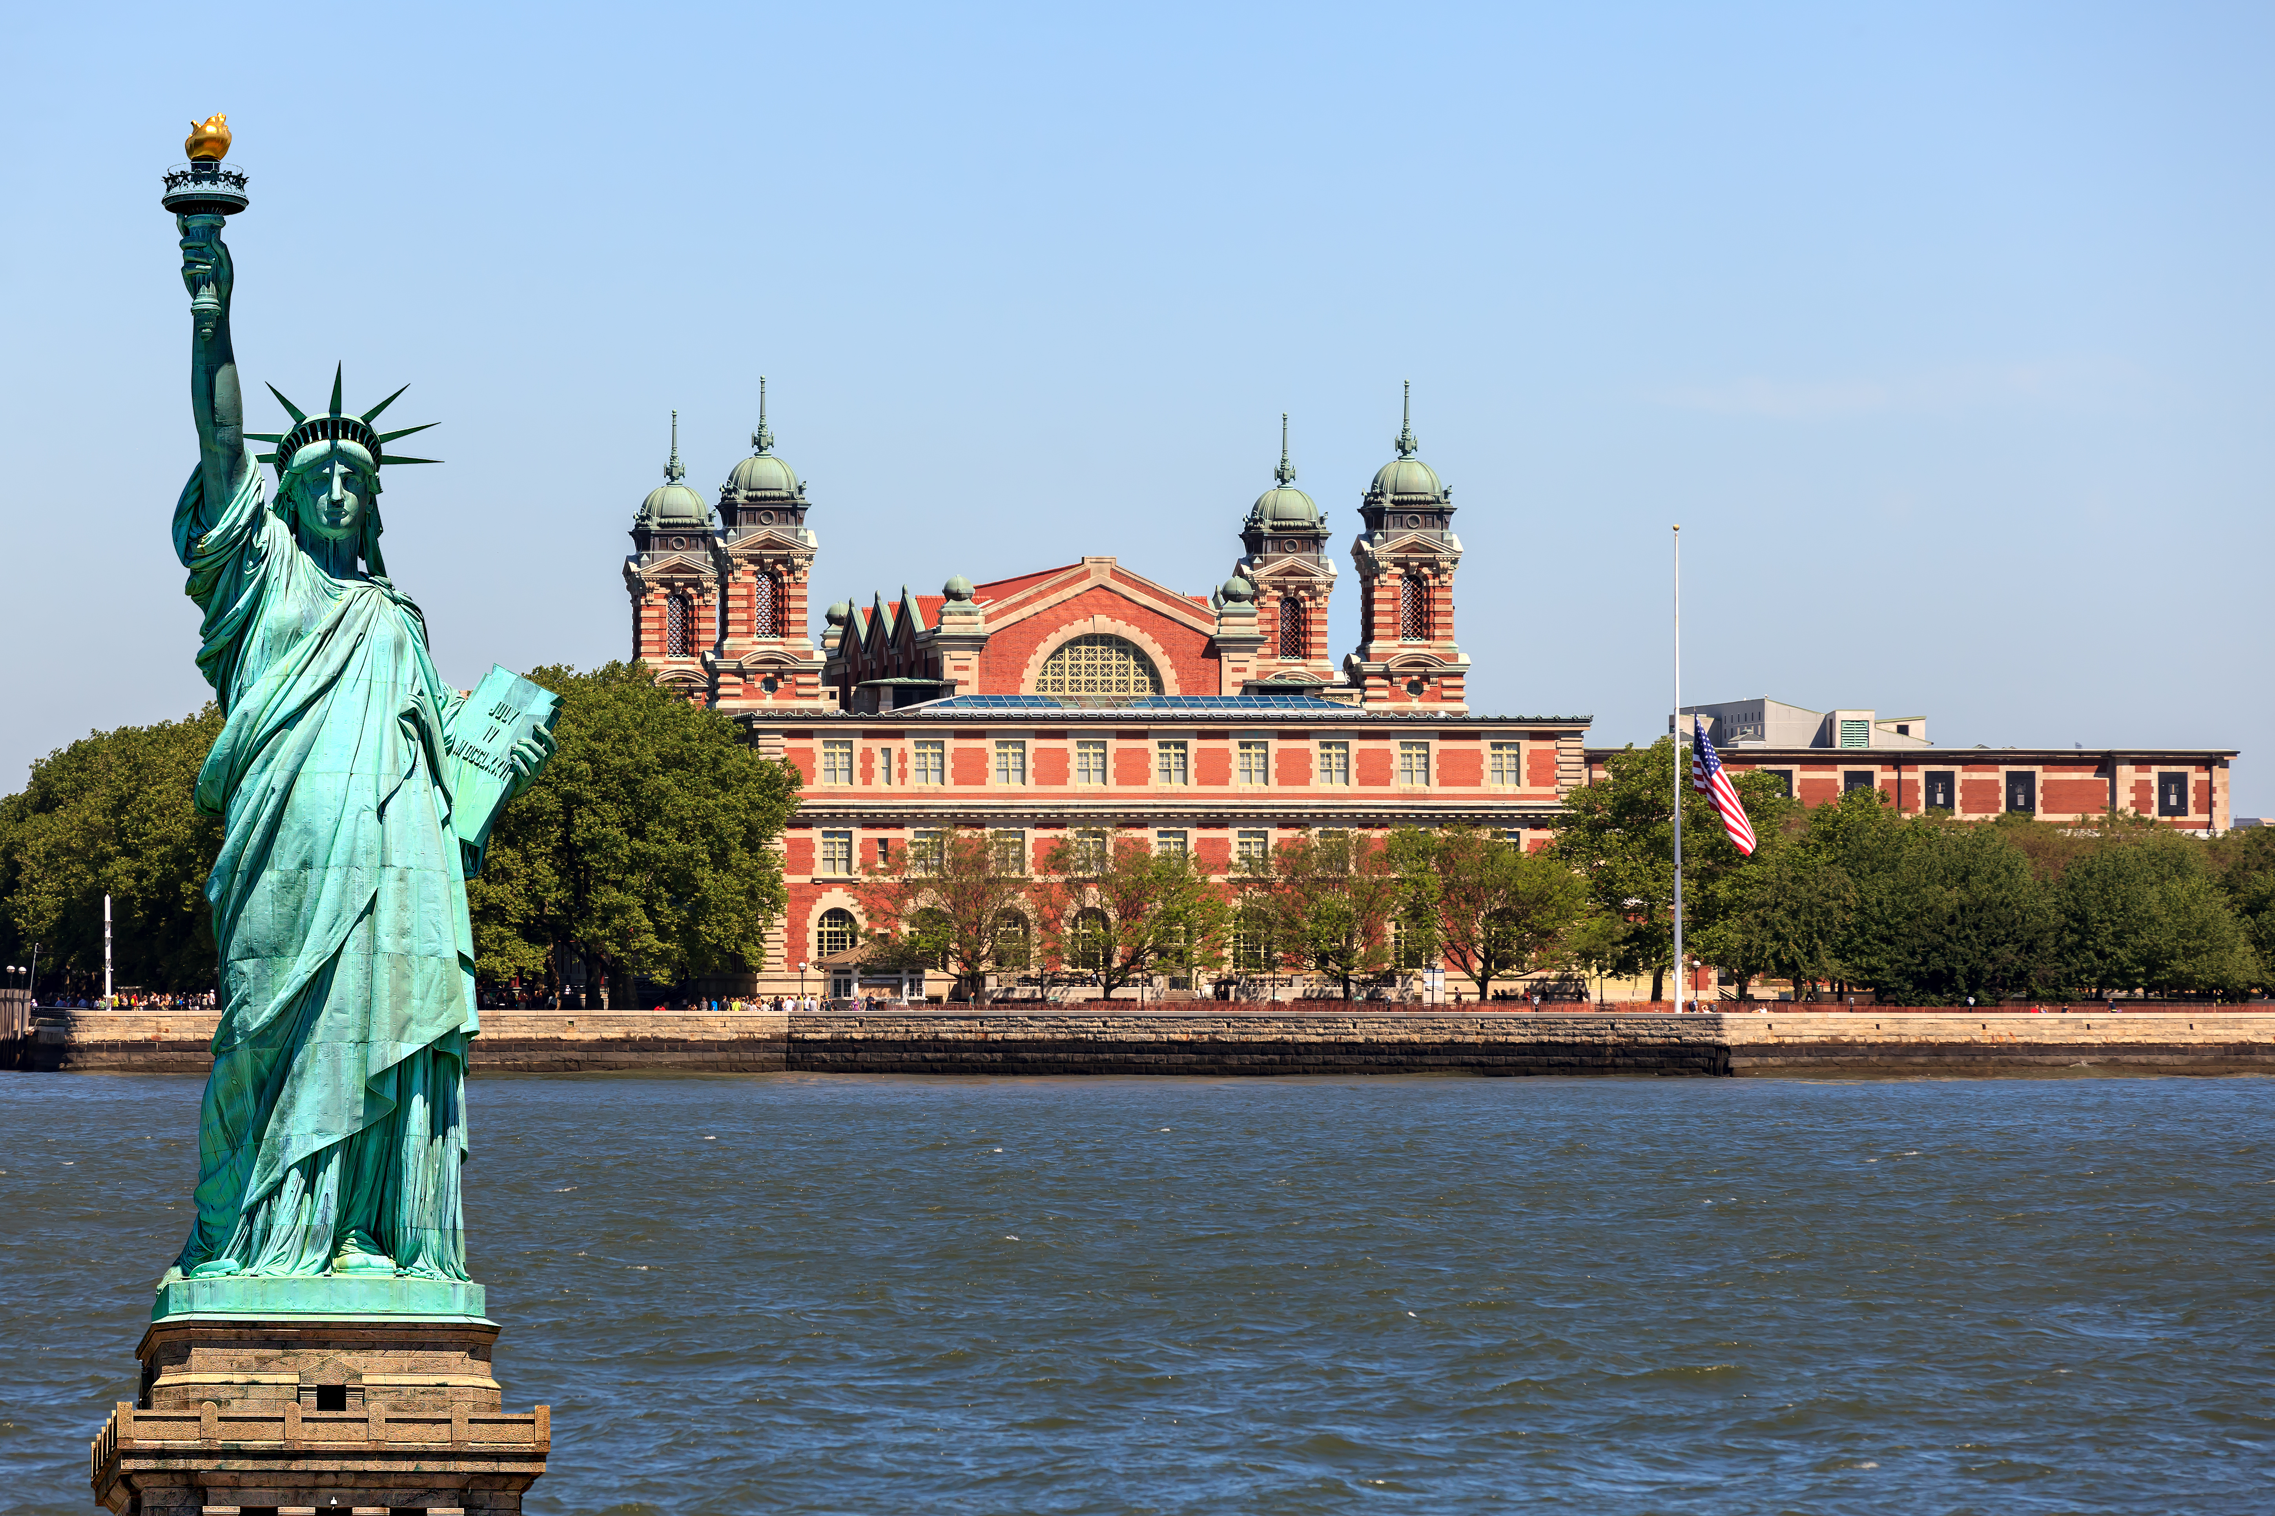
Immigration
Will President Trump deport segments of the undocumented population?
Will President Trump restrict legal immigration?
Immigration is key to U.S. economic growth.

Slide 4
Asset valuation equation
$$\frac{NOI \left(1+g\right)^n}{WACC−g}$$
WACC is the weighted cost of capital.
Note that interest rates and the libor curve are up 25% since the election.
This is due to expected higher demand, higher inflation, and higher debt levels that need to be financed.
QUESTION: Will lower taxes, infrastructure projects and repatriation of U.S. corporate earnings from abroad produce higher growth?

